Slide 1
Session 2
E-R Model and Normalization

Slide 2
Review
A database is a collection of related data stored in the form of a table.
The flat file system proved to be very time consuming. It had limitations of data redundancy, poor data control, and inability to easily manipulate data.
A Database Management System can be defined as a collection of related records and a set of programs that access and manipulate these records.
A data model describes a container for storing data and the process of storing and retrieving data from that container.
DBMS is a collection of programs that enables the user to store, modify, and extract information from a database.
A Relational Database Management System (RDBMS) is a suite of software programs for creating, maintaining, modifying, and manipulating a relational database.
A relational database is divided into logical units called tables. These logical units are interrelated to each other within the database.

Slide 3
Session Objectives
Define and describe data modeling.
Identify and describe the components of the E-R model.
Identify the relationships that can be formed between entities.
Explain what E-R diagrams are and why they are useful.
Describe an E-R diagram, the symbols used for drawing and show the various relationships.
Describe the various Normal Forms.
Outline the uses of different Relational Operators.

Slide 4
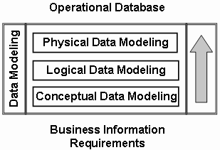
Data Modeling
Data Model - a group of conceptual tools that describes data, its relationships and semantics. It also consists of the consistency constraints that the data adheres to.
Data modeling can be broken down into three broad steps:
  Conceptual Data Modeling
  Logical Data Modeling
  Physical Data Modeling

Slide 5
Entity-Relationship (ER) model 1-4
Data models can be classified into three different groups:
  Object-based logical models
  Record-based logical models
  Physical models
The Entity-Relationship (E-R) model belongs to the first classification. The model is based on a simple idea. Data can be perceived as real world objects called entities and the relationships that exist between them.
An E-R model consists of five basic components. They are:
  Entity
  Relationship
  Attributes
  Entity Set
  Relationship Set
Employee Entity Set
Department Entity Set
€
€
€
€
€
Relationship Set
€
Human Resource
€
€
€
€
works in
Production
€
€
€
€
€
Accounts
Logistics
Department Entities
Employee Entities

Slide 6
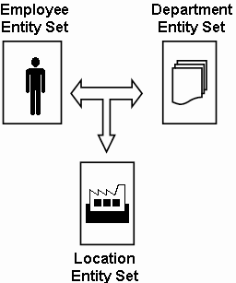
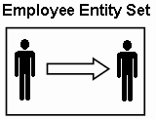
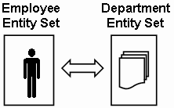
Entity-Relationship (ER) model 2-4
Relationships associate one or more entities. They can be of three types:
  Self relationships: Relationships between entities of the same entity set are called self relationships.
  Ternary relationships: Relationships that exist between three entities of different entity sets are called ternary relationships.
  Binary relationships: Relationships that exist between entities of two different entity sets are called binary relationships.

Slide 7
Entity-Relationship (ER) model 3-4
Relationships can also be classified as per mapping cardinalities. The different mapping cardinalities are:
  One-to-One: This kind of mapping exists when an entity of one entity set can be associated with only one entity of another set.
  One-to-Many: This kind of mapping exists when an entity of one set can be associated with more than one entity of another entity set.
Vehicle Entity Set

Vehicle Entity Set
 
 
 
Registration Entity Set
Customer Entity Set

 
€
 
 
registration


Slide 8
Entity-Relationship (ER) model 4-4
  Many-to-One: This kind of mapping exists when many entities of one set is associated with an entity of another set. This association is done irrespective of whether the latter entity is already associated to other or more entities of the former entity set.
  Many-to-Many: This kind of mapping exists when any number of entities of one set can be associated with any number of entities of the other entity set.
Vehicle Entity set

 
 
 
Location Entity set
Customer Entity Set
Account Entity Set

€
 
☞
€


Slide 9
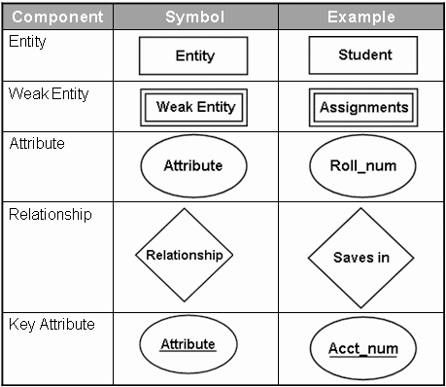
Entity-Relationship Diagrams
The E-R diagram is a graphical representation of the E-R model.
The symbols used for the various components can be seen in the following table:

Slide 10
Entity-Relationship Diagrams
Steps to construct an E-R diagram are:
  Gather all the data that needs to be modeled.
  Identify data that can be modeled as real world entities.
  Identify the attributes for each entity.
  Sort entity sets as weak or strong entity sets.
  Sort entity attributes as key attributes, multi-valued attributes, composite attributes, derived attributes.
  Identify the relations between the different entities.
  Using the different symbols draw the entities, their attributes and their relationships. Use appropriate symbols while drawing attributes.

Slide 11
Normalization
It is the process of efficiently organizing data in a database.
There are two goals of the normalization process: eliminate redundant data and ensure data dependencies make sense.
Initially, Codd (1972) presented three normal forms (1NF, 2NF and 3NF), all based on dependencies among the attributes of a relation.
  First Normal Form - In order to achieve the first normal form:
    Create separate tables for each group of related data
    The table columns must have atomic values
    All the key attributes must be identified

Slide 12
Normalization
  Second Normal Form - The tables are said to be in second normal form if:
    They meet the requirements of the first normal form
    There are no partial dependencies in the tables
    The tables are related through foreign keys
  Third Normal Form - To achieve the third normal form:
    The tables should meet the requirements of the second normal form
    The tables should not have transitive dependencies in them

Slide 13
Relational Operators
The relational model is based on the solid foundation of Relational Algebra, which consists of a collection of operators that operate on relations.
Each operator takes one or two relations as its input and produces a new relation as its output.
  SELECT: This operator is used to extract data that satisfies a given condition. The lowercase Greek letter sigma, “σ”, is used to denote selection.
  PROJECT: This operator is used to project certain details of a relational table. It only displays the required details leaving out certain columns. The PROJECT operator is denoted by the Greek letter pi, “π”.
  PRODUCT: This operator is denoted by “x”. It helps combine information from two relational tables.

Slide 14
Relational Operators
  UNION: The UNION operator collects data from different tables and presents a unified version of the complete data. The union operation is represented by the symbol, “U”.
  INTERSECT: This operator generates data that holds true in all the tables it is applied on. It is based on the intersection set theory and is represented by the “∩” symbol.
  DIFFERENCE: This operator, symbolized as “-”. It generates data from different tables, that holds true in one table and not the other.
  JOIN: The join operation is an enhancement to the product operation. It allows a selection to be performed on the product of tables.
  DIVIDE: The division operation, denoted by “÷”, is suited to queries that include the phrase “for all”.

Slide 15
Summary
Data modeling is the process of applying an appropriate data model to the data at hand.
E-R model views the real world as a set of basic objects and relationships among them.
Entity, attributes, entity set, relationships and relationship sets form the five basic components of E-R model.
Mapping cardinalities express the number of entities an entity is associated with.
The process of removing redundant data from the tables of a relational database is called normalization.
Relational Algebra consists of a collection of operators that help retrieve data from the relational databases.

